Slide 1
Principal Component Analysis (PCA)
Hongyu Guo
2025

Slide 2
Why Factor or Component Analysis?
We study phenomena that can not be directly observed
  ego, personality, intelligence in psychology
  Underlying factors that govern the observed data
We want to identify and operate with underlying latent factors rather than the observed data
  E.g. topics in news articles
  Transcription factors in genomics
We want to discover and exploit hidden relationships
  “beautiful car” and “gorgeous automobile” are closely related
  So are “driver” and “automobile”
  But does your search engine know this?
  Reduces noise and error in results

Slide 3
Why Factor or Component Analysis?
We have too many observations and dimensions
  To reason about or obtain insights from
  To visualize
  Too much noise in the data
  Need to “reduce” them to a smaller set of factors
  Better representation of data without losing much information
  Can build more effective data analyses on the reduced-dimensional space: classification, clustering, pattern recognition
Combinations of observed variables may be more effective bases for insights, even if physical meaning is obscure

Slide 4
Factor or Component Analysis
Discover a new set of factors/dimensions/axes against which to represent, describe or evaluate the data
  For more effective reasoning, insights, or better visualization
  Reduce noise in the data
  Typically a smaller set of factors: dimension reduction
  Better representation of data without losing much information
  Can build more effective data analyses on the reduced-dimensional space: classification, clustering, pattern recognition
Factors are combinations of observed variables
  May be more effective bases for insights, even if physical meaning is obscure
  Observed data are described in terms of these factors rather than in terms of original variables/dimensions

Slide 5
Basic Concept
Areas of variance in data are where items can be best discriminated and key underlying phenomena observed
  Areas of greatest “signal” in the data
If two items or dimensions are highly correlated or dependent
  They are likely to represent highly related phenomena
  If they tell us about the same underlying variance in the data, combining them to form a single measure is reasonable
    Parsimony
    Reduction in Error
So we want to combine related variables, and focus on uncorrelated or independent ones, especially those along which the observations have high variance
We want a smaller set of variables that explain most of the variance in the original data, in more compact and insightful form

Slide 6
Principal Components Analysis ( PCA)
Principal Component Analysis (PCA) is a technique used in statistics and data analysis to simplify the complexity in high-dimensional data while retaining trends and patterns.
When PCA is performed, it seeks to find the principal components (or directions) along which the data varies the most.
Can be used to:
  Reduce number of dimensions in data
  Find patterns in high-dimensional data
  Visualize data of high dimensionality
Example applications:
  Face recognition
  Image compression
  Gene expression analysis

Slide 7
Principal Component Analysis
The new variables/dimensions
  Are linear combinations of the original ones
  Are uncorrelated with one another
    Orthogonal in original dimension space
  Capture as much of the original variance in the data as possible
  Are called Principal Components

Slide 8
Variance is a measure of how spread out a set of values are. In the context of PCA, the idea is to capture the directions in the data where the variance is maximized.
  The first principal component represents the direction of maximum variance
  The second principal component represents the second highest variance, and so on.
By focusing on the directions with the highest variance, PCA helps reduce the dimensionality of the data while preserving as much of the original variability as possible.
In simpler terms, PCA mentions variance because it's all about identifying and retaining the most significant sources of variation in the data.

Slide 9
Principal Components Analysis Ideas ( PCA)
Does the data set ‘span’ the whole of d dimensional space?
For a matrix of m samples x n genes, create a new covariance matrix of size n x n.
Transform some large number of variables into a smaller number of uncorrelated variables called principal components (PCs).
developed to capture as much of the variation in data as possible

Slide 10
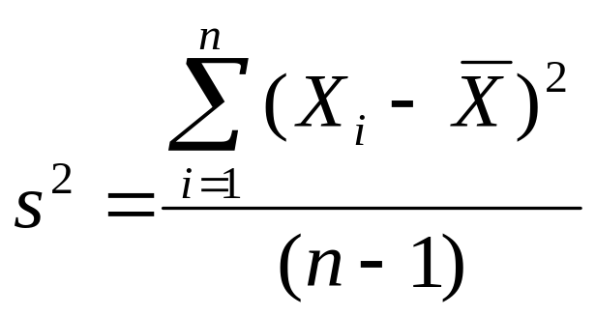
Principal Component Analysis: one attribute first
Temperature
42
40
24
30
15
18
15
30
15
30
35
30
40
30
Question: how much spread is in the data along the axis? (distance to the mean)
Variance=Standard deviation^2

Slide 11
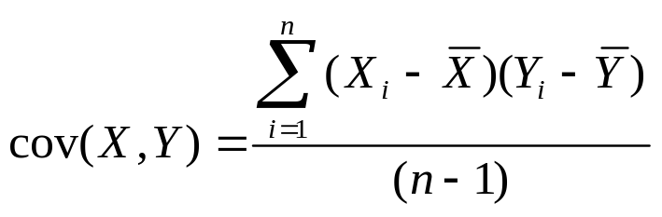
Now consider two dimensions
X=Temperature | Y=Humidity
40 | 90
40 | 90
40 | 90
30 | 90
15 | 70
15 | 70
15 | 70
30 | 90
15 | 70
30 | 70
30 | 70
30 | 90
40 | 70
30 | 90
Covariance: measures the
correlation between X and Y
cov(X,Y)=0: independent
Cov(X,Y)>0: move same dir
Cov(X,Y)<0: move oppo dir

Slide 12
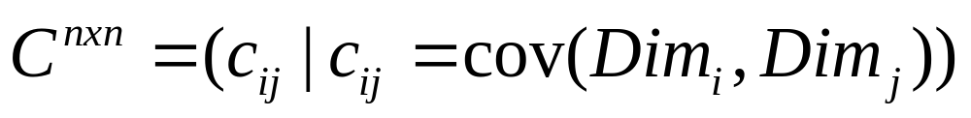
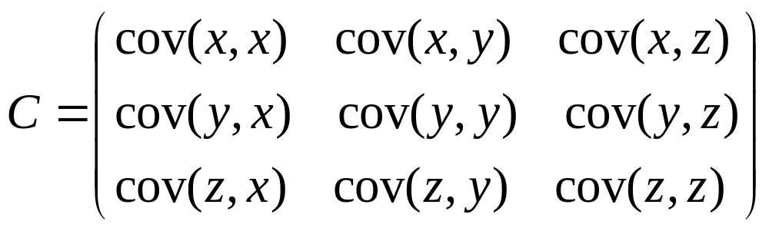
More than two attributes: covariance matrix
Contains covariance values between all possible dimensions (=attributes):
Example for three attributes (x,y,z):

Slide 13
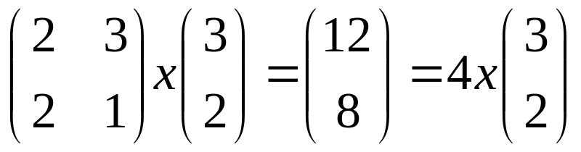
Eigenvalues & eigenvectors
Vectors x having same direction as Ax are called eigenvectors of A (A is an n by n matrix).
In the equation Ax=λx, λ is called an eigenvalue of A.

Slide 14
Eigenvalues & eigenvectors
Ax=λx ⇔ (A-λI)x=0
How to calculate x and λ:
  Calculate det(A-λI), yields a polynomial (degree n)
  Determine roots to det(A-λI)=0, roots are eigenvalues λ
  Solve (A- λI) x=0 for each λ to obtain eigenvectors x

Slide 15
Principal components
1. principal component (PC1)
  The eigenvalue with the largest absolute value will indicate that the data have the largest variance along its eigenvector, the direction along which there is greatest variation
2. principal component (PC2)
  the direction with maximum variation left in data, orthogonal to the 1. PC
In general, only few directions manage to capture most of the variability in the data.

Slide 16

Steps of PCA
Let be the mean vector (taking the mean of all rows)
Adjust the original data by the mean
  X’ = X –
Compute the covariance matrix C of adjusted X
Find the eigenvectors and eigenvalues of C.
For matrix C, vectors e (=column vector) having same direction as Ce :
  eigenvectors of C is e such that Ce=λe,
  λ is called an eigenvalue of C.
Ce=λe ⇔ (C-λI)e=0
  Most data mining packages do this for you.

Slide 17
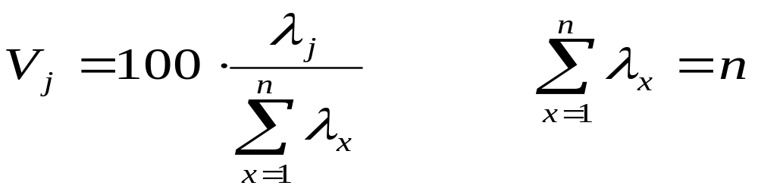
Eigenvalues
Calculate eigenvalues λ and eigenvectors x for covariance matrix:
  Eigenvalues λ_{j} are used for calculation of [% of total variance] (V_{j}) for each component j:

Slide 18
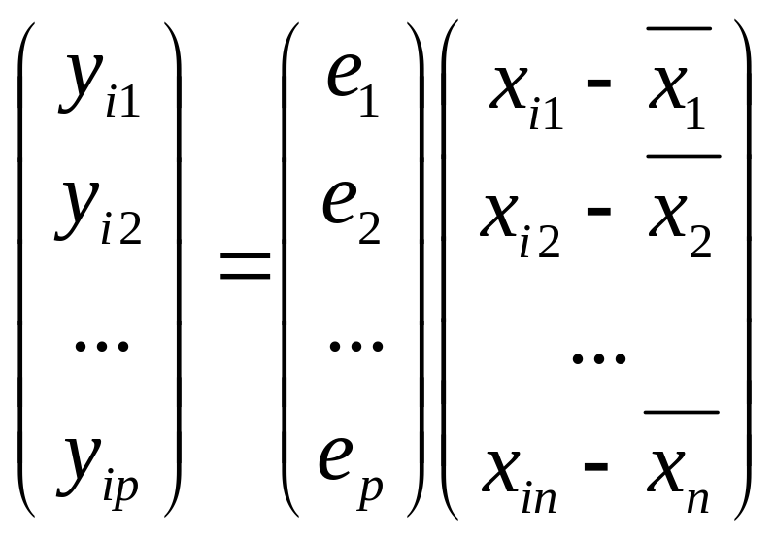
Transformed Data
Eigenvalues λ_{j} corresponds to variance on each component j
Thus, sort by λ_{j}
Take the first p eigenvectors e_{i;} where p is the number of top eigenvalues
These are the directions with the largest variances

Slide 19
PCA –> Original Data
Retrieving old data (e.g. in data compression)
  RetrievedRowData=(RowFeatureVector^{T} x FinalData)+OriginalMean
  Yields original data using the chosen components

Slide 20
How Many PCs?
For n original dimensions, correlation matrix is nxn, and has up to n eigenvectors. So n PCs.
Where does dimensionality reduction come from?

Slide 21
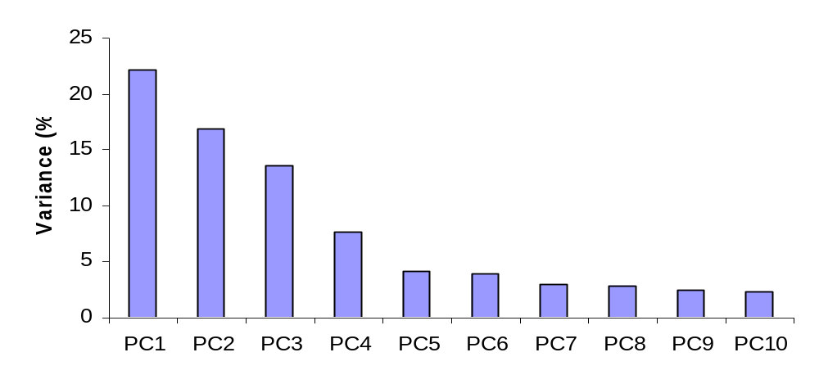
Dimensionality Reduction
Can ignore the components of lesser significance.
You do lose some information, but if the eigenvalues are small, you don’t lose much
  n dimensions in original data
  calculate n eigenvectors and eigenvalues
  choose only the first p eigenvectors, based on their eigenvalues
  final data set has only p dimensions

Slide 22

While dimensionality reduction is an important tool in machine learning/data mining, we
must always be aware that it can distort the data in misleading ways.
Above is a two dimensional projection of an intrinsically three dimensional world….

Slide 23

Original photographer unknown
See also www.cs.gmu.edu/~jessica/DimReducDanger.htm
(c) eamonn keogh

Slide 24
Principal components
General about principal components
  summary variables
  linear combinations of the original variables
  uncorrelated with each other
  capture as much of the original variance as possible

